Slide 1
AI and Data Management tools for Research
Antoine Valera – 18/09/2025

Slide 2
Program
1. Git & GitHub
2. LLM
3. ChatGPT to the rescue
4. GitHub Copilot
5. IDE Integration
6. Agents

Slide 3
1. GitHub

Slide 4
Common Issues
Work Protection
"My computer crashed and I lost all my changes from today!"
"I deleted something important last week but I can't find it in any of my backups...“
Research Reproducibility
"The reviewers want us to modify Figure 3, but I can't remember exactly how I generated it..."
"Can we reproduce the analysis we did 6 months ago?"
"Which version of the preprocessing script did we use for the published results?“
“Can we test the new segmentation method they used in the micro-sam paper on our data?”
Version Management
"Which one of these is my latest version? script_v3_final_FINAL_tested.py or script_v3_final_FINAL_tested_new.py?"
"I know I have the working version somewhere in my Downloads folder...“
"I need to try a different approach but I don't want to break the working code..."
Collaboration
"I'll send you my version via email - just don't edit it until I'm done with my part!“
"Wait, did you change the code? I was working on that same section...“
" Can you tell me what you modified? We're going to need to manually compare these two files to merge our work...“

Slide 5
Common Issues
Work Protection
Reliable backup system, Ability to recover changes, Safe space for experimentation
Research Reproducibility
Ability to replicate experiments exactly, Documentation of analysis steps, Tracing which code produced which results
Version Management
Keeping track of file versions, Managing code evolution
Collaboration
Sharing code effectively, Integrating changes from multiple researchers, Keeping everyone's work synchronized

Slide 6
What is Version Control? What is Git?
Version Control
A system that records changes to files over time (incrementally)
Acts like a "time machine" for your code and documents
Keeps track of who changed what, when, and why
Git
The most widely used version control system
Free, open-source, and industry standard
Keep tracking changes in the background while you work

Slide 7

How git works
Computer 1
Git clone
🤓 You at work : File 1 V1 File 2 V1 …
🤓 You at work : File 1 V2 File 2 V1 …
Git commit
You save snapshots ("commits") of your files
Each snapshot has a message explaining the changes
You can go back to any previous snapshot
🤓 You at work : File 1 V3 File 2 V2 …
Git commit
Git push
Server
Computer 2
Git pull
🦉 You at home : File 1 V3 File 2 V2 …
😱 You at home : File 1 V2 File 2 V2 …
Git commit
Git push

Slide 8
GitHub workflow
Computer 1
Computer 1
🤓 You at work : File 1 V2 File 2 V2 …
Git clone
🤓 You at work : File 1 V1 File 2 V1 …
🤓 You at work : File 1 V2 File 2 V1 …
Git commit
🤓 You at work : File 1 V3 File 2 V2 …
Git commit
Server
Git push
Server
Computer 2
Git pull
🦉 You at home : File 1 V3 File 2 V2 …
😱 You at home : File 1 V2 File 2 V2 …
Git commit
Git push

Slide 9
GitHub workflow
Computer 1
Computer 3
🤓 You at work : File 1 V2 File 2 V2 …
👶Your collaborator : File 1 V2 File 2 V2 …
Git clone
🤓 You at work : File 1 V2 File 2 V4 …
👶Your collaborator : File 1 V4 File 2 V2 …
Git commit
Git commit
Git push / Git pull
Git push / Git pull
🤓 You at work : File 1 V4 File 2 V4 …
👶Your collaborator : File 1 V4 File 2 V4 …
Server
Multiple people can work on the same project safely
Multiple people can work on the same file simultaneously
Git includes system to resolve merging conflicts
➔ For more complex scenario, we can use “branches”

Slide 10
Common Issues
Work Protection
Reliable backup system, Ability to recover changes, Safe space for experimentation
Research Reproducibility
Ability to replicate experiments exactly, Documentation of analysis steps, Tracing which code produced which results
Version Management
Keeping track of file versions, Managing code evolution
Collaboration
Sharing code effectively, Integrating changes from multiple researchers, Keeping everyone's work synchronized

Slide 11
GitHub workflow
Computer 1
Computer 3
🤓 You at work : File 1 V2 File 2 V2 …
👶Your collaborator : File 1 V2 File 2 V2 …
🤓 You at work : File 1 V2 File 2 V4 …
👶Your collaborator : File 1 V4 File 2 V2 …
Git commit
Server branch 1 / branch 2
Git commit
Git push / Git pull
Git push / Git pull
🤓 You at work : File 1 V4 File 2 V4 …
👶Your collaborator : File 1 V4 File 2 V4 …
Server
➔ Major or simultaneous changes may not be compatible

Slide 12
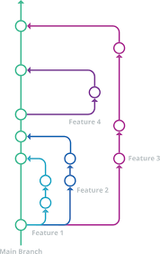
Branches
Main Branch (Green)
→ The primary version of your project
→ Think of it as your "production" or "stable" code
Feature Branches (Blue, Purple)
→ Create a branch to work independently on new features without affecting main code
Basic Operations
→ PULL: Get latest changes from remote repository
→ PUSH: Send your changes to remote repository
→ MERGE: Combine changes from a feature branch back to main
This branching system allows multiple people to work simultaneously without conflicts

Slide 13
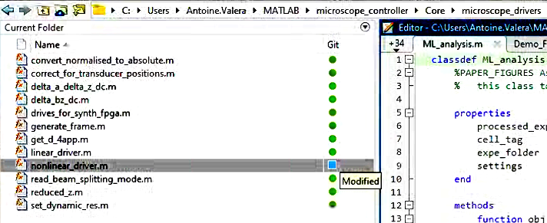
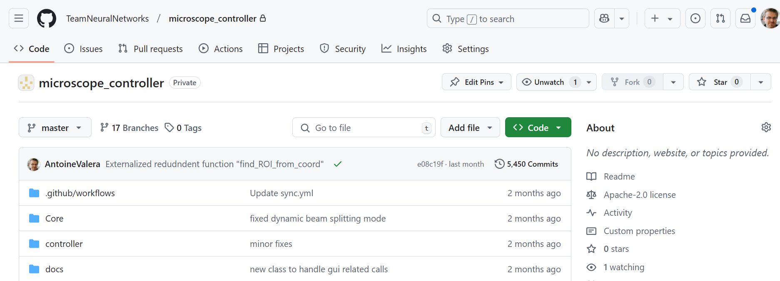
Git vs. GitHub/GitLab
Git
The version control system itself
Runs on your computer
Tracks changes in your files
Works completely offline
Hosting Platforms
Store Git repositories online
Provide collaboration features
Different options available:
GitHub (Microsoft)
GitLab (can be self-hosted)
Bitbucket (By Atlassian)
SourceForge (Older platform)

Slide 14
Important Note: GitHub ≠ Backup System
GitHub stores your code, but...
→ Not designed as a backup solution
→ Limited file size (100MB per file)
→ No guaranteed uptime or redundancy
What to use GitHub for
→ Code version control and collaboration
→ Documentation and small data files
→ Project management and issue tracking
What NOT to use GitHub for
Large datasets
Sensitive or private data
System backups
Binary files (images, videos, etc.)
➔ Use proper backup solutions (lab servers, institutional storage, etc.) for your research data

Slide 15
GitHub Structure
Users (individual mail address)
Organizations (e.g., Institute repository, Team repository)
→ Groups multiple related projects/labs under one umbrella
→ Manages team access and permissions centrally
Example: Our institute INCI's organization, my team webpage
Repositories (e.g., microscope_controller)
→ Individual projects or code bases
→ Can be public or private
Can be owned by Users or Organizations
Example: my microscope controller software project

Slide 16

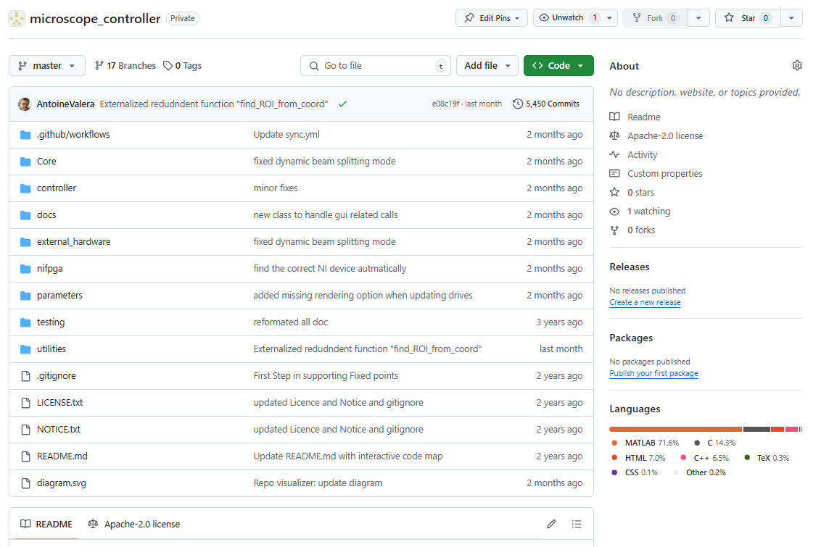
What does GitHub look like

Slide 17
What does GitHub look like
Example of organization with Public and Private repositories
https://github.com/TeamNeuralNetworks/
Example of Private repository
https://github.com/TeamNeuralNetworks/microscope_controller
Example of Public repository with a DOI
https://github.com/TeamNeuralNetworks/the-inspiring-tuby-sniff
Example of “hub”
https://github.com/SilverLabUCL/SilverLab-Microscope
https://github.com/NeuroStrasbourg/

Slide 18
GitHub Repository Structure
Key Areas of a Repository
→ Code: Where your files live
→ Issues: Track bugs and feature requests
→ Pull Requests: Propose and review changes
→ Projects: Organize and track work
→ Wiki: Project documentation
→ Settings: Manage repository configuration
Navigation
→ Top menu for core features
→ README displays automatically on homepage
→ Sidebar for additional information
→ Watch/Star/Fork buttons for engagement

Slide 19
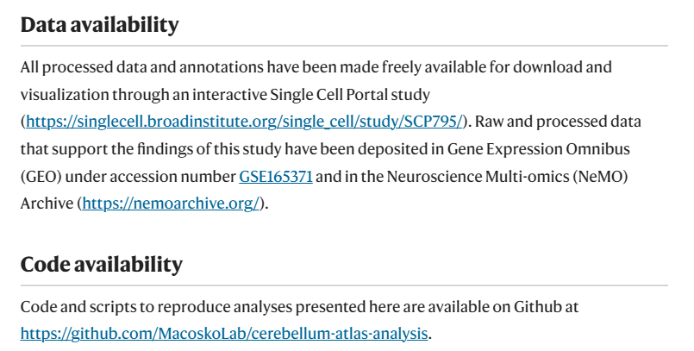
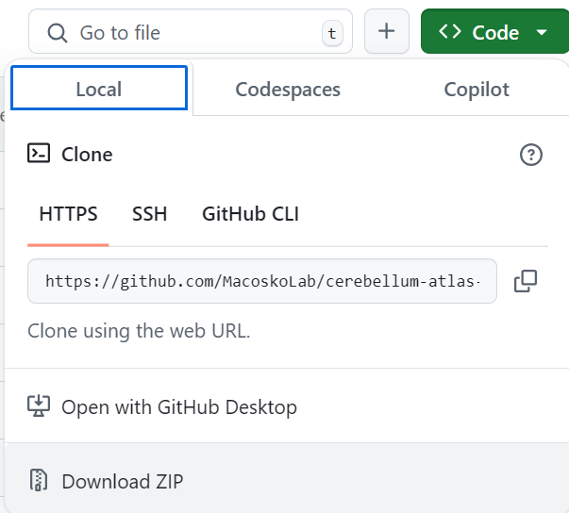
How do I use Github?
To access public repositories : nothing to do
1) Regular repo
https://www.nature.com/articles/s41586-021-03220-z
https://github.com/MacoskoLab/cerebellum-atlas-analysis
2) Colab : https://github.com/neuro4ml/exercises?tab=readme-ov-file
3) Ressources : https://github.com/ywang2822/Multi_Lick_ports_behavioral_setup

Slide 20
How do I use Github?
For editing Repositories, Three Ways
1 : Web Interface (github.com)
Great for browsing, quick edits, and project management
No installation needed, works everywhere. Not for cloning
2 : GitHub Desktop (this is what I use)
User-friendly application for Windows/Mac
Visual interface for common Git operations
3 : Command Line Interface (this is what I use when I do not have any choice)
Most powerful and flexible (all the github options)
Standard in software development
Required for advanced operations
➔ Each method can be used interchangeably based on your needs and comfort level

Slide 21
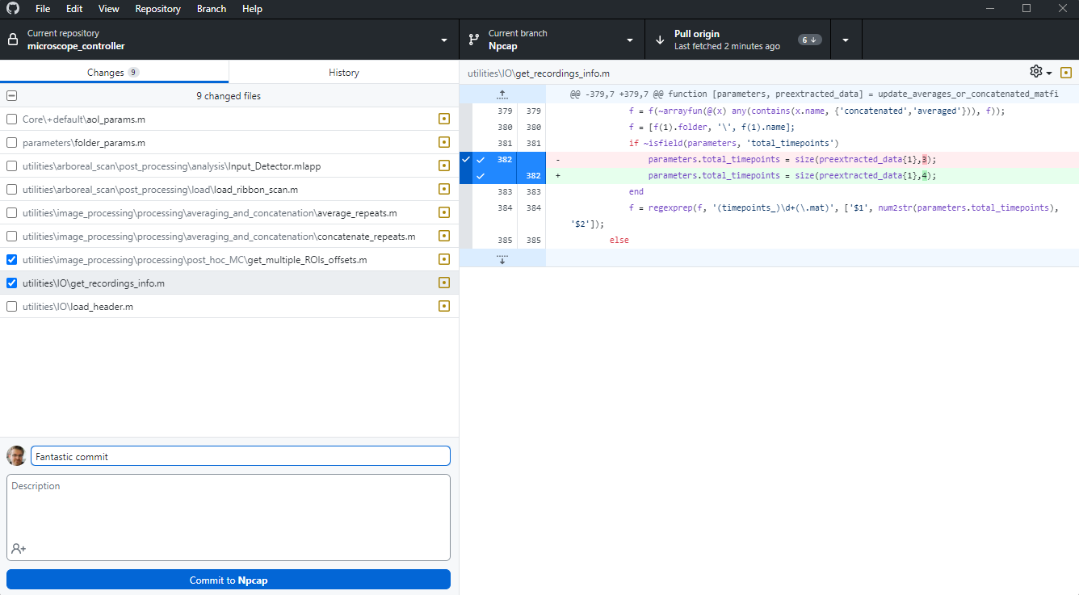
Github Desktop - demo

Slide 22
GitHub Benefits for Academia
Free GitHub Pro for Education at no cost Available for students, researchers, and teachers
https://education.github.com/discount_requests/application
GitHub Copilot Included
→ Works in GitHub's web editor
→ Integrates with VS Code and other IDEs for code suggestions in real-time
What Copilot Can Do
→ Suggests code completions and whole functions
→ Helps write documentation and comments
→ Understands context from your code
→ Assists with data analysis snippets
To Get Access : sign up in GitHub Education, using your unistra mail address. Teachers can get 2 pro accounts for organizations

Slide 23
2. LLM

Slide 24
Defintion
A large language model (e.g., GPT-5) is a Transformer neural network trained by next-token prediction on massive text to perform NLP tasks (generate text, answer questions, summarize, code), by learning statistical patterns.
Text from websites, books, articles, blogs; programming resources like GitHub code snippets, documentation, Stack Overflow; science content such as academic papers, arXiv, PubMed (often abstracts unless full text is licensed)
It doesn’t think like a human, it predicts likely next words. Newer models (GPT-5) follow multi-step instructions more reliably, but can still be wrong, so verify important claims.

Slide 25
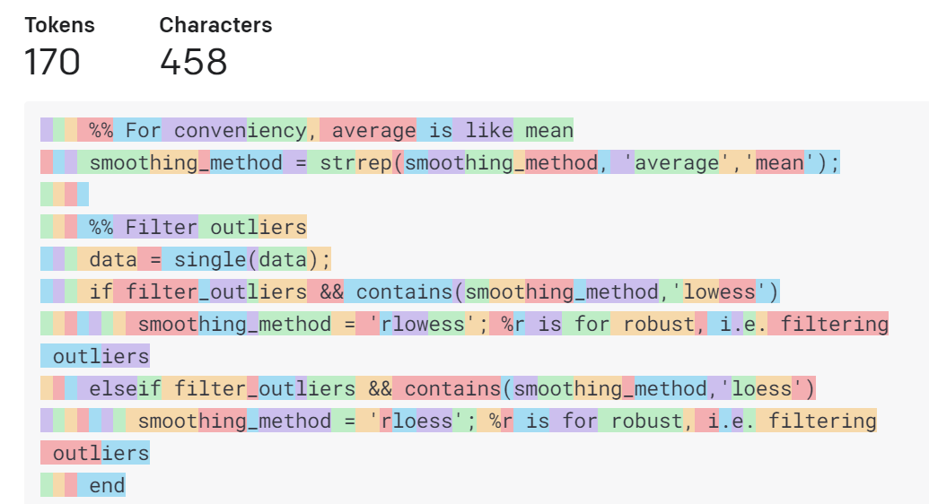
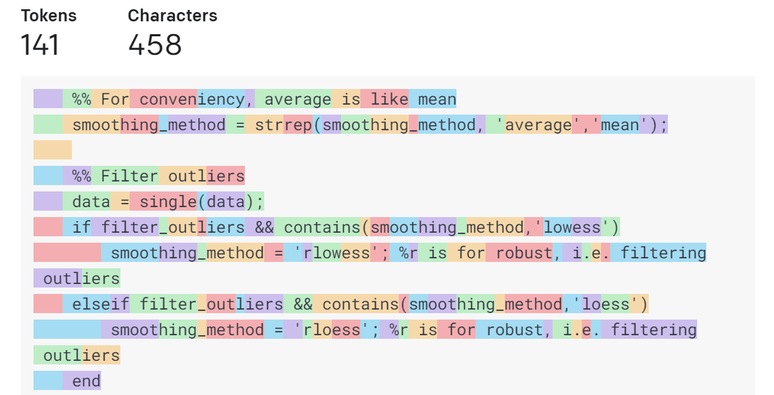
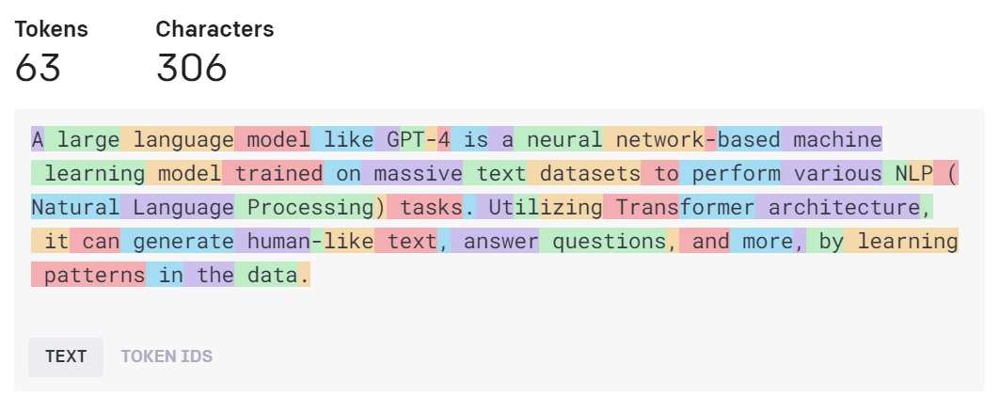
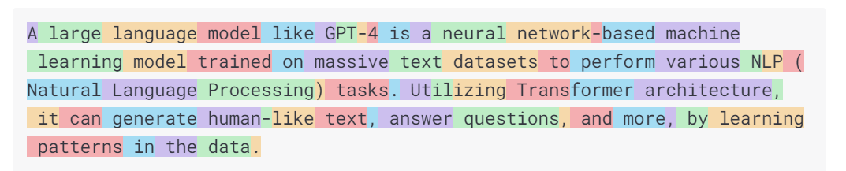
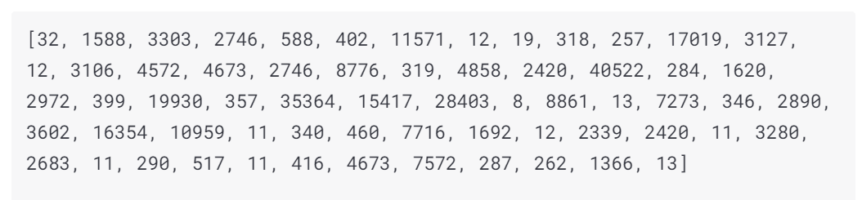
Tokens
Dataset unit is a token. It is the quantum of information in LLMs
Text
Code
Code with Codex

Slide 26
Why Using LLM’s (in science)
Faster than most web search : a first answer can be quickly obtained. It can help you learn and use correct jargon. Vague statements are usually rephrased in clearer terms first.
Open new options : You can list tools for analysis you would not have considered before
Improve workflow : Take out tedious steps to focus on the goal and select the means to achieve them
Lower the barriers to complex tools : Easier to join a new project

Slide 27
Limitations
No Knowledge of truth
Hallucinations Incomplete and poorly identified references No Long term memory
Obsolescence
Multimodality

Slide 28
Limitations
No Knowledge of truth
Hallucinations
Incomplete and poorly identified references
No Long term memory
Obsolescence
Multimodality

Slide 29
3. ChatGPT (and claude, gemini etc…)

Slide 30
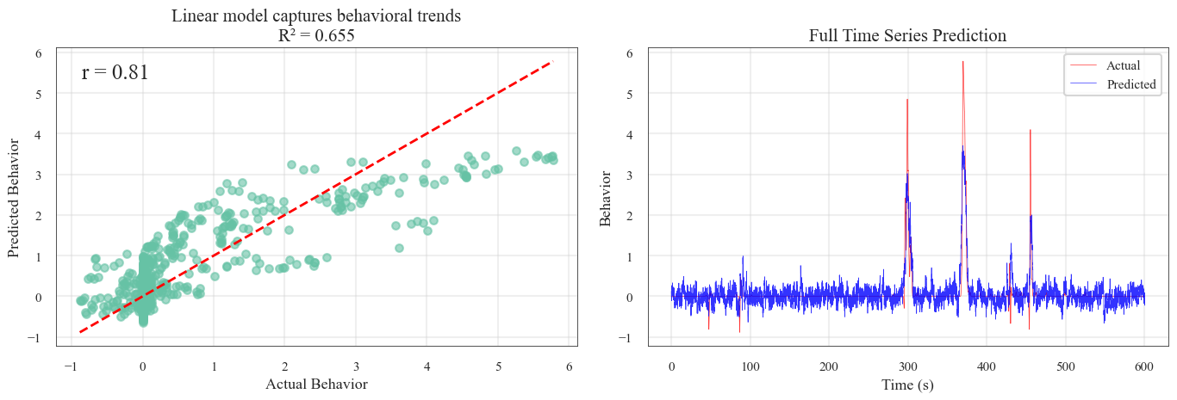
Find ideas
Find me a fancy, fast to install neuroscience repository that would give me a state of the art non linear dimensionality reduction for later cluster. Something simple to use like phate but even better
my linear regression model is good but when looking at the relation ship between predicted running speed and real one, using calcium imaging data, here is the result.
What do you think?
See : DemoChatGPT.py

Slide 31
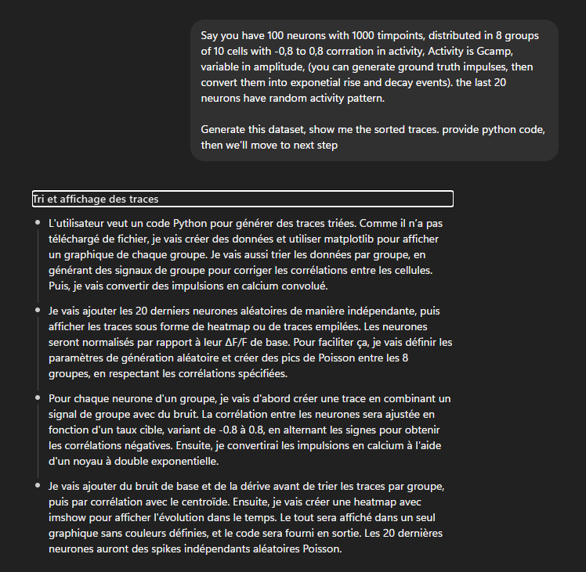
Regular prompt
import numpy as np
import matplotlib.pyplot as plt
rng = np.random.default_rng(123)
# ---------- sizes ----------
n_neurons = 100
t_points = 1000
dt = 0.1
time_axis = np.arange(t_points) * dt
# ---------- labels (8 groups of 10 + 20 random) ----------
group_labels = np.concatenate([np.full(10, g) for g in range(1, 9)] + [np.full(20, 9)])
# ---------- correlation targets per structured group ----------
group_corr_targets = {g: rng.uniform(-0.8, 0.8) for g in range(1, 9)}
# ---------- GCaMP-like double-exponential kernel ----------
tau_rise, tau_decay = 0.2, 1.2
kt = np.arange(0, int(5*tau_decay/dt)) * dt
kernel = (1 - np.exp(-kt/tau_rise)) * np.exp(-kt/tau_decay)
kernel /= kernel.max()
def convolve_events(spikes_bool, amps):
impulse = np.zeros(spikes_bool.size, dtype=float)
impulse[spikes_bool] = amps
return np.convolve(impulse, kernel, mode='full')[:spikes_bool.size]
def safe_corr(x, y):
sx, sy = x - x.mean(), y - y.mean()
vx, vy = np.linalg.norm(sx), np.linalg.norm(sy)
if vx < 1e-12 or vy < 1e-12: return 0.0
return float(np.dot(sx, sy) / (vx * vy))
# ---------- generate fluorescence ----------
fluor = np.zeros((n_neurons, t_points))
idx = 0
for g in range(1, 9):
# group latent bursts
base_rate = 0.7 # Hz
group_spikes = rng.random(t_points) < (base_rate*dt)
burst_on = rng.random(t_points) < 0.015
for b in np.where(burst_on)[0]:
group_spikes[b:b+6] = True
# opponent mask for anti-correlation (prefer when group is quiet)
quiet_mask = ~group_spikes
# optional dilation to strengthen complementarity
from scipy.ndimage import binary_dilation
quiet_mask = binary_dilation(quiet_mask, iterations=2)
group_amps = np.exp(rng.normal(np.log(1.0), 0.4, size=group_spikes.sum()))
group_latent = convolve_events(group_spikes, group_amps)
c = group_corr_targets[g]
mag = np.clip(abs(c), 1e-3, 0.99)
for _ in range(10):
if c >= 0:
# positively correlated: shared latent + private events
private = rng.random(t_points) < (0.25*dt)
priv_amps = np.exp(rng.normal(np.log(0.7), 0.5, size=private.sum()))
priv_latent = convolve_events(private, priv_amps)
drive = np.sqrt(mag) * group_latent + np.sqrt(1-mag) * priv_latent
else:
# negatively correlated: events mostly when group is quiet
opp = (rng.random(t_points) < (0.6*dt)) & quiet_mask
opp |= (rng.random(t_points) < (0.05*dt)) # small random background
opp_amps = np.exp(rng.normal(np.log(1.0), 0.5, size=opp.sum()))
opp_latent = convolve_events(opp, opp_amps)
drive = np.sqrt(mag) * opp_latent + np.sqrt(1-mag) * (0.3 * group_latent)
gain = rng.uniform(0.9, 1.4)
baseline = rng.uniform(0.4, 0.8)
noise = rng.normal(0, 0.02, size=t_points)
trace = baseline + gain * drive + noise
trace = np.maximum(trace, 0.05) # keep physical (non-negative)
fluor[idx] = trace
idx += 1
# random neurons (independent)
for _ in range(20):
rate = rng.uniform(0.1, 1.0)
spikes = rng.random(t_points) < (rate*dt)
amps = np.exp(rng.normal(np.log(0.9), 0.5, size=spikes.sum()))
latent = convolve_events(spikes, amps)
gain = rng.uniform(0.7, 1.3)
baseline = rng.uniform(0.3, 0.9)
noise = rng.normal(0, 0.03, size=t_points)
trace = np.maximum(baseline + gain*latent + noise, 0.05)
fluor[idx] = trace
idx += 1
# ---------- convert to dF/F ----------
calcium_dff = np.zeros_like(fluor)
for i in range(n_neurons):
F0 = max(np.percentile(fluor[i], 20), 1e-3)
calcium_dff[i] = (fluor[i] - F0) / F0
# ---------- sort by group then by correlation to group centroid ----------
sort_index = []
for g in range(1, 10): # 1..8 groups + 9=“random”
ii = np.where(group_labels == g)[0]
if ii.size == 0:
continue
block = calcium_dff[ii]
centroid = block.mean(axis=0)
cors = np.array([safe_corr(tr, centroid) for tr in block])
sort_index.extend(ii[np.argsort(-cors)].tolist())
sort_index = np.array(sort_index)
dff_sorted = calcium_dff[sort_index]
labels_sorted = group_labels[sort_index]
# ---------- plot sorted traces (heatmap) ----------
plt.figure(figsize=(12, 6))
im = plt.imshow(dff_sorted, aspect='auto', interpolation='nearest')
plt.xlabel('Time (samples)')
plt.ylabel('Neurons (sorted by group & prototypicality)')
plt.title('Synthetic GCaMP dF/F — Sorted Traces')
cbar = plt.colorbar(im)
cbar.set_label('dF/F0')
row = 0
for g in range(1, 10):
cnt = np.sum(labels_sorted == g)
if cnt > 0:
plt.hlines(row + cnt - 0.5, xmin=0, xmax=t_points-1, linewidth=1)
row += cnt
plt.tight_layout()
plt.show()

Slide 32
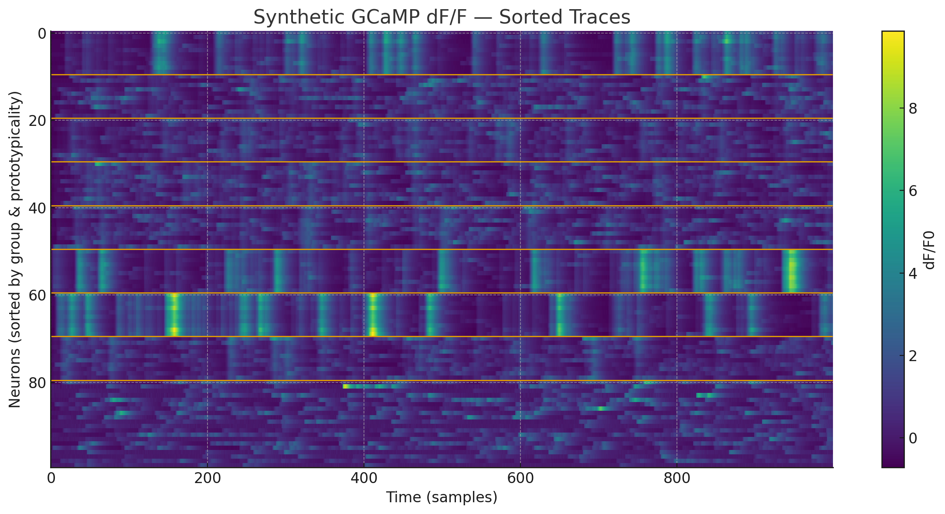
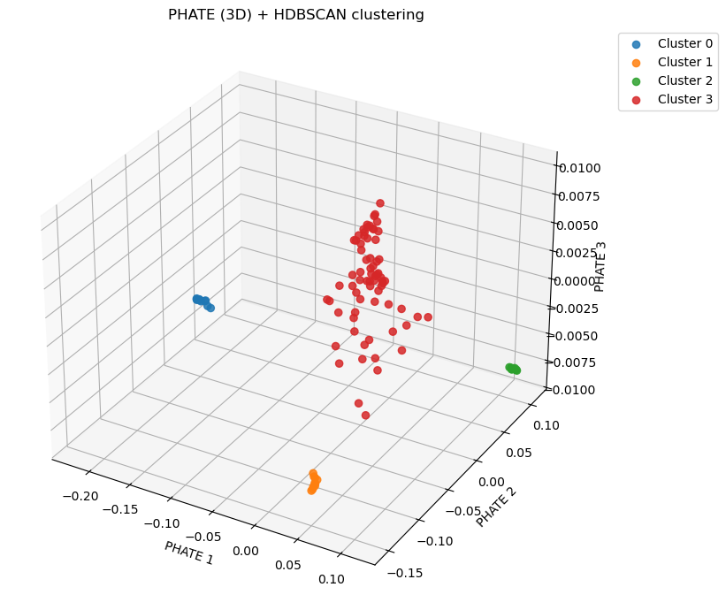
Code output

Slide 33
Great for brainstorming & scoping pipelines; can surface relevant papers — always verify DOIs/PMIDs.
Writes small, focused code blocks; translates MATLAB ↔ Python; can refactor, vectorize, add docstrings & tests.
Debugs by explaining errors and proposing minimal reproducible examples.
Python sandbox for quick checks (fixed environment & libs): perfect for tiny demos, plots, CSVs; not for long runs/heavy deps.
Can draft loaders/boilerplate for .mat/NWB/TIFF, quick PCA/Clustering stubs, and figure templates.
➔ What about multi-files code ? 2-4 files, you can still throw them at it. More? See AGENTS

Slide 34
4. Copilot

Slide 35
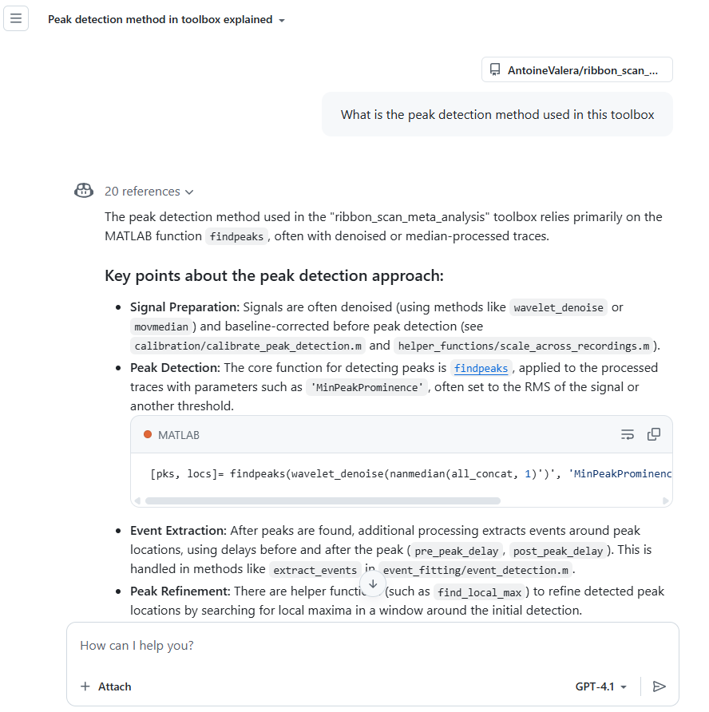
GitHub Copilot on Github.com
To find repo doing a specific function
To understand how a repo works
To find a specific function or snippet in the code
To see how to use / hack the code for your usage
To ask how to implement the repo for your own data
To understand bugs, settings etc…

Slide 36
5. IDE Integration

Slide 37
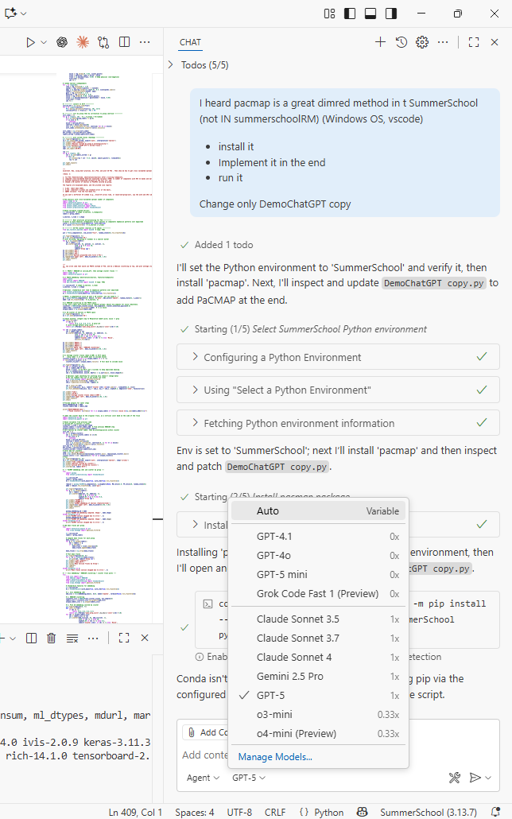
In your IDE
Officially supported editors/IDEs
Visual Studio Code.
Visual Studio 2022+ (Windows).
JetBrains IDEs (IntelliJ IDEA, PyCharm, WebStorm, Rider, CLion, PhpStorm, GoLand, RubyMine, DataGrip, DataSpell, Android Studio, etc.).
Vim/Neovim (official `copilot.vim` plugin for completions).
Eclipse (official plugin).
Azure Data Studio (official extension).
Public preview
Xcode (code completion + Copilot Chat in public preview). ([The GitHub Blog][7])
Notes on Copilot Chat
Chat is officially available in VS Code, Visual Studio, and JetBrains IDEs; Neovim chat exists via community plugins (e.g., CopilotChat.nvim).

Slide 38
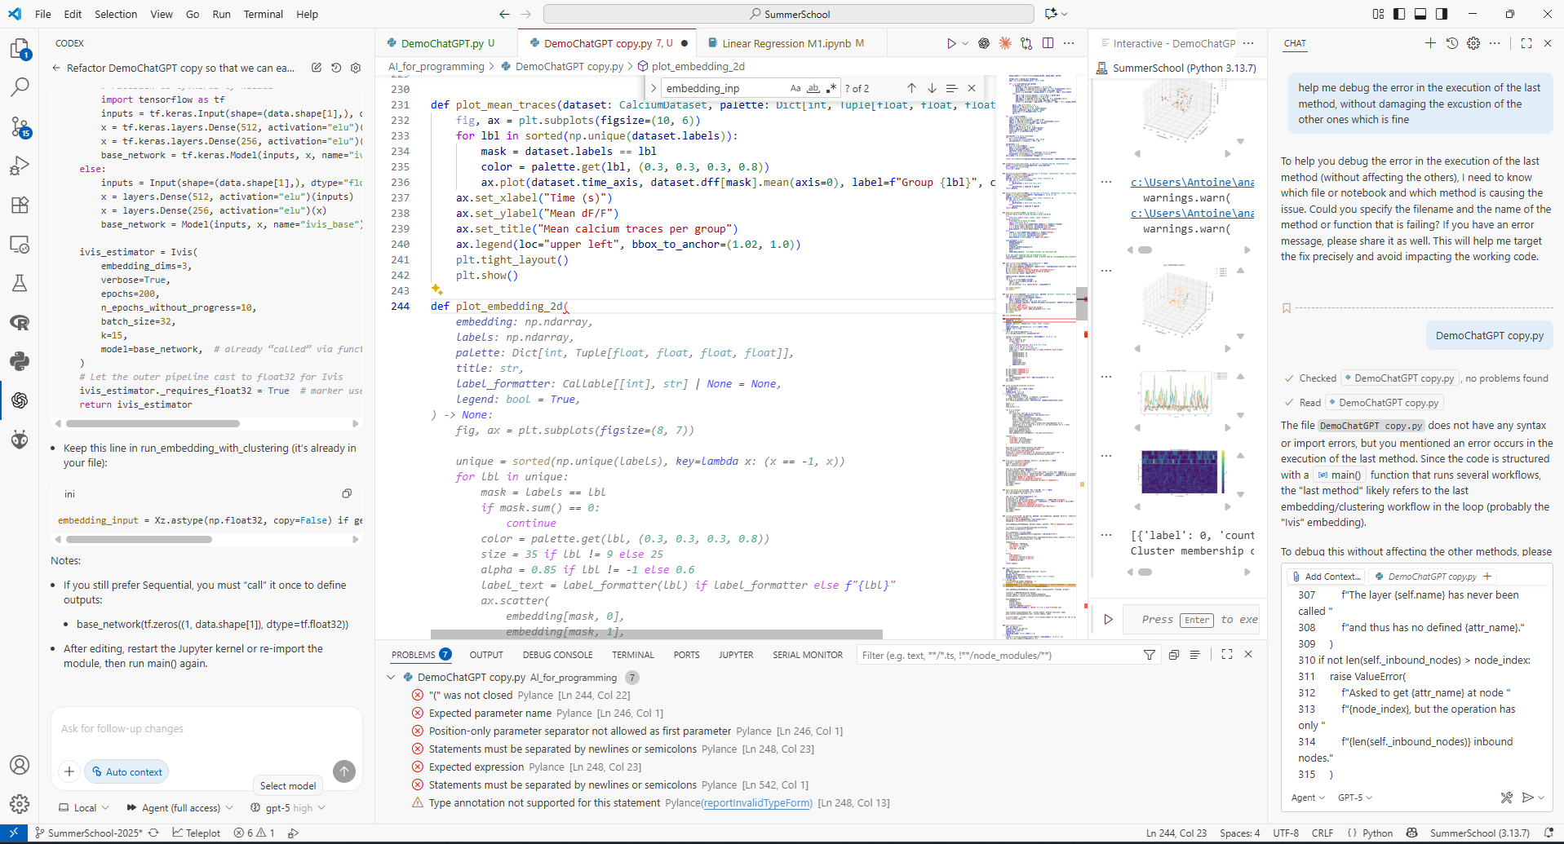

VS Code
ChatGPT
Copilot
Intellisense
Autofill
GitHub
Conda

Slide 39

6. Agents

Slide 40
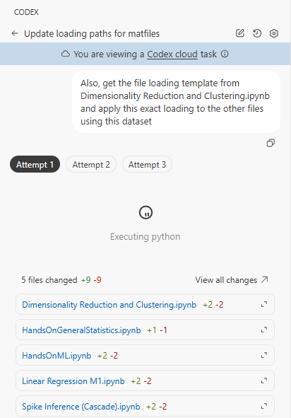
Demo copilot and VScode
Notes:
https://github.com/SilverLabUCL/microscope_controller
Where are the function that controls analog I/O
how do i start the GUI?
# write a function that generate random noise and plot it
# write a function that generate random noise and plot it
import numpy as np
import matplotlib.pyplot as plt
def generate_noise():
return np.random.normal(0, 1, 1000)
def plot_noise():
noise = generate_noise()
plt.plot(noise)
plt.show()
if __name__ == "__main__":
plot_noise()

Slide 41
Thank you for your attention!
The presentation will be available on

